Slide 1

Landslide detector
Using Arduino

Slide 2
01
02
ABOUT US
About Landslide
03
04
Arduino Intro
Sensor used
05
06
IOT Info.
Sensors Output

Slide 3
HELLO!
We are making landslide detector
with help of using Arduino and its
Various sensors.

Slide 4

About us
Krishna-10316210059
Manoj-10316210067
Prateek-10316210092
We Are the team of three…namely Krishna ,Manoj and Prateek

Slide 5
What is LandSlide!
A landslide, is a geological phenomenon that includes a wide range of ground movements.
Landslides, in general, include all downward or sudden movement of surface material like clays, sand, gravel and rock.
These natural disasters have occurred in all part of Himachal Pradesh as well in highly hilly area.
And the most important thing: It is not unpredictable like earthquake .It can be detect
By using certain measures

Slide 6
LandSlide DEMOGRAPHICS
20%
India
56k
Deaths
AGE
NATIONALITIES
5 - 13
https://www.deccanherald.com/national/india-tops-world-landslide-689244.html
13 - 15

Slide 7

Causes of Landslide
Weathering
Earthquake
All the natural bio-chemical alteration and physical breakdown of rocks
Usually before earthquake small trembles are felt . They can be detected
structural
Human causes
1.Slope angle
2.Soil erosion at critical areas
Vibrations from heavy traffic, blasting, etc.

Slide 8
The primary cause of a landslide is the influence of gravity acting on weakened materials that make up a sloping area of land.
These factors can be analyzed and data can be used for prediction and prevention .
So on the basis of data collected we can build a landslide detector

Slide 9

FOR DETECTION WE USE ARDUINO
The Arduino hardware and software was designed for artists, designers, hobbyists, hackers, newbies, and anyone interested in creating interactive objects or environments. Arduino can interact with buttons, LEDs, motors, speakers, GPS units, cameras, the internet, and even your smart-phone or you’re TV!

Slide 10
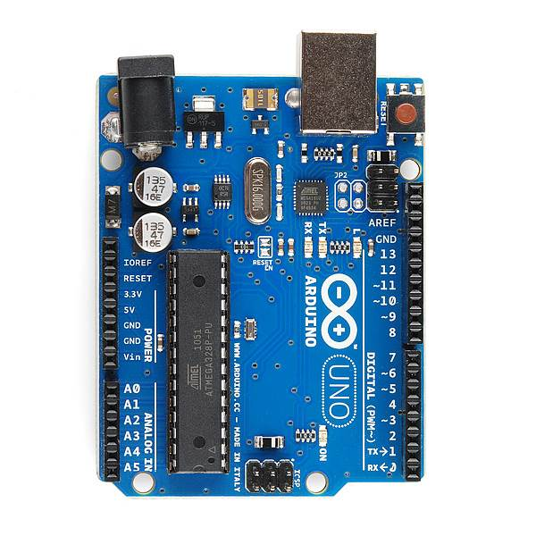
Arduino
USB
(to Computer)
PWR IN
RESET
SCL\SDA
(I2C Bus)
POWER
5V / 3.3V / GND
Digital I\O
PWM(3, 5, 6, 9, 10, 11)
Analog INPUTS

Slide 11
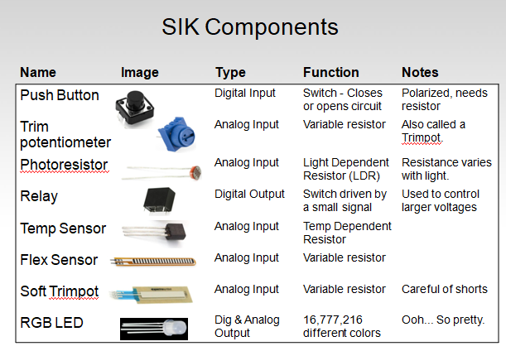
SIK Components

Slide 12
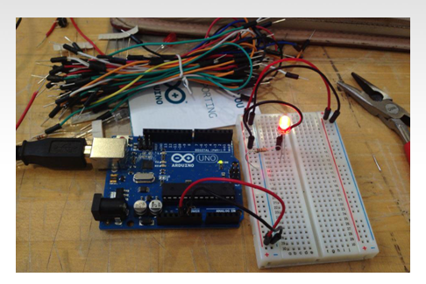
—SOMEONE FAMOUS
Arduino Programming with Breadboard
“Arduino ko explain
Sari board walli information aayegi”

Slide 13

Requirements
1.Arduino Uno(ATmega328)
2.Sensors
-Accelometer sensor
-Soil moisture sensor
-rain sensor
3.Gsm module
4.Wires
5.Breadboard
6.Windows based pc
7.Buzzer

Slide 14

Arduino sensors
Soil Moisture sensor
Rain sensor
Accelerometer
GPS Module

Slide 15


Slide 16
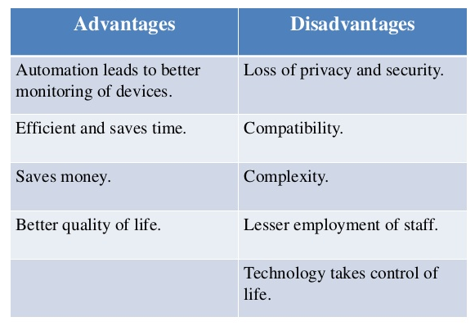

Slide 17
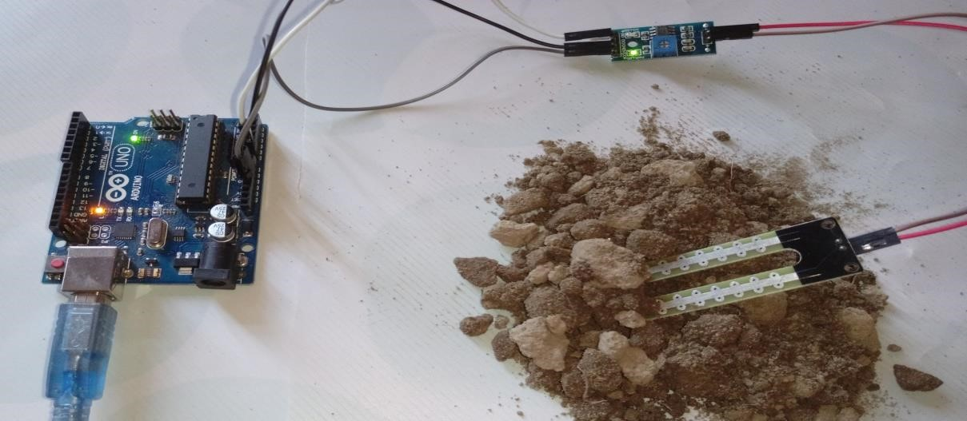
Soil Moisture Sensor

Slide 18
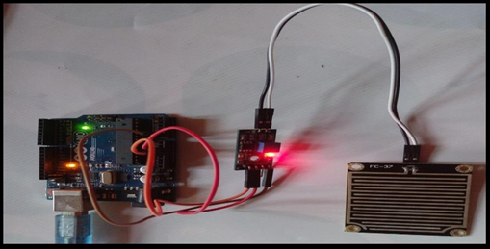
Rain Sensor Circuit

Slide 19
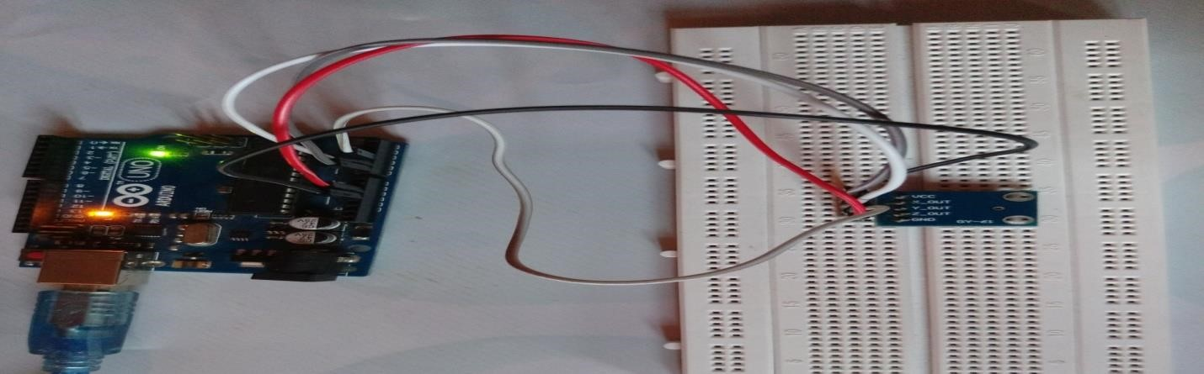
ACCELEROMETER Sensor

Slide 20
Each sensor has its own code to be provided to arduino Ide

Slide 21
Sensor output

Slide 22
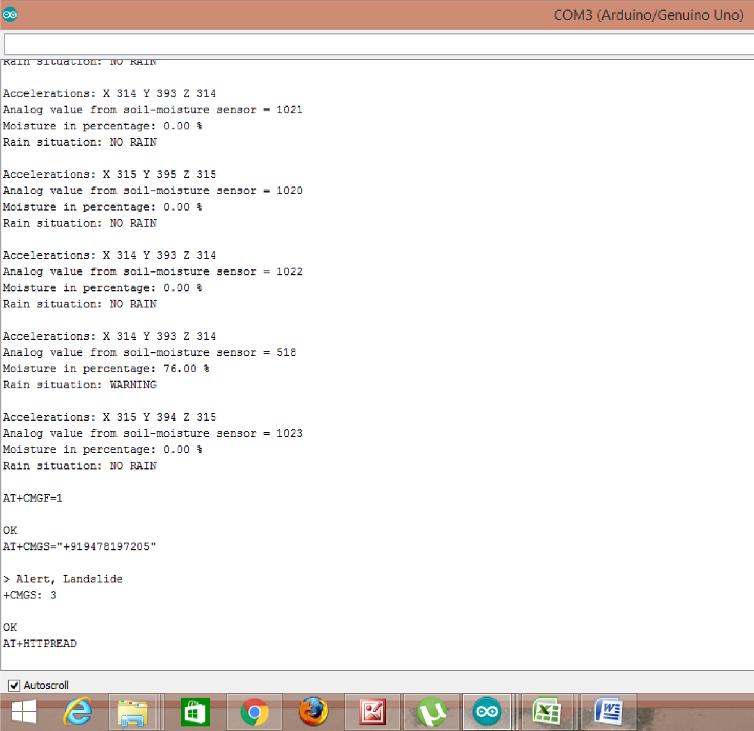

Slide 23

THANKS
Does anyone have any questions?
Jhonhancock99@gmail.com

